Slide 1


Stephen Grace and David McElroy
DCC EPSRC, Glasgow 08 may 2014

Slide 2
Our remit from UEL RDM policy
RDS will provide:
Central source of information, guidance and contacts on research data management through the UEL website
Infrastructure and support service includes
a register of datasets
a portal for datasets
an annual progress report

Slide 3
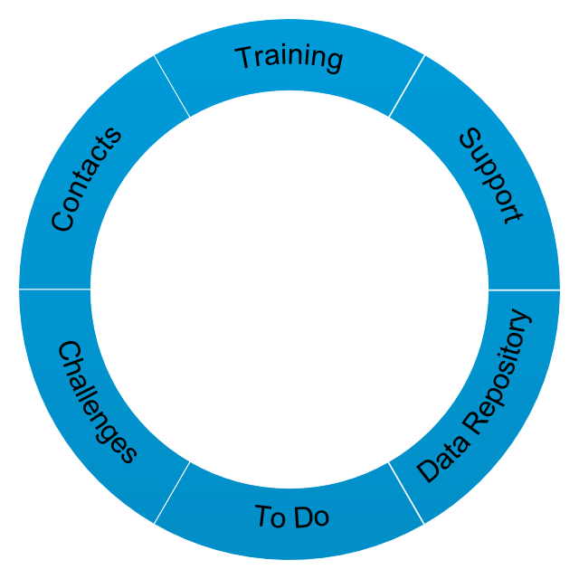

Slide 4
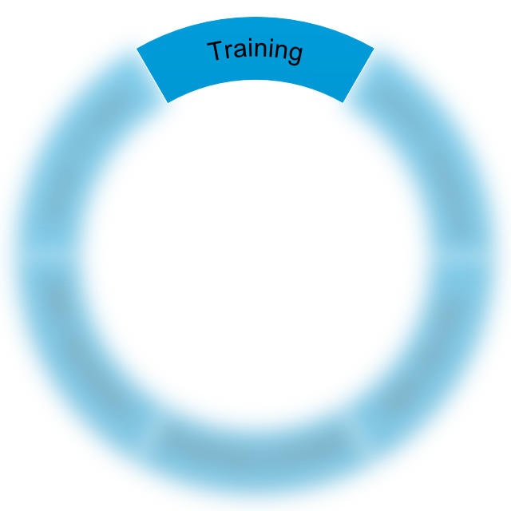
Adopted in Graduate School’s Researcher Development Programme
Very popular and quite well attended
Staff and PGR students attend
Partially tailored to the expected requirements of those attending

Slide 5

Consultation for DMPs
One on one support for other RDM needs
Meeting our research institutes to discuss how we can help support them

Slide 6

Capital funding secured
Requirements agreed with software partner (ULCC)
Use ReCollect as base
Register of all datasets
CRIS-like features (may be superseded by actual CRIS)
2 way flow of data between
data repo and
publications repo
Integration with
DataCite for minting DOIs

Slide 7

Finish our support pages
Launch the Data Repository in July
Helpdesk/ticketing system for logging all interactions
Publicise our presence within UEL

Slide 8
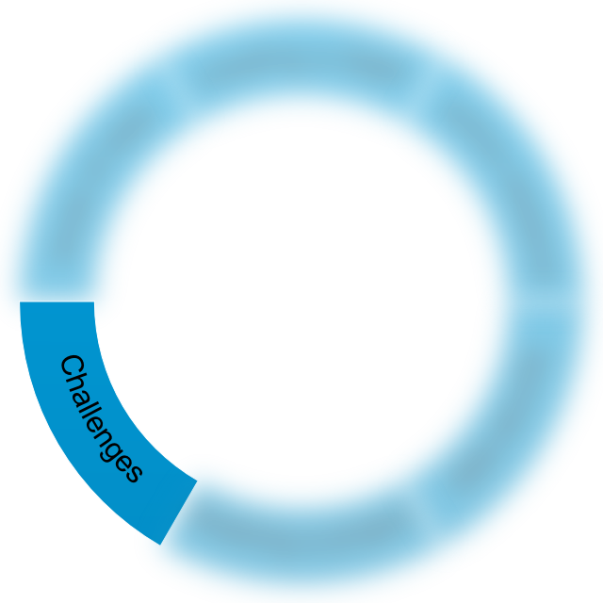
Non digital data not yet considered
Active data storage
Formal business planning – there are advantages to perpetual beta, but budgeting isn’t one of them

Slide 9

David McElroy, UEL RDM Officer
d.mcelroy@uel.ac.uk
Stephen Grace,Research Services Librarian
s.grace@uel.ac.uk

Slide 10
Thank you

